Slide 1
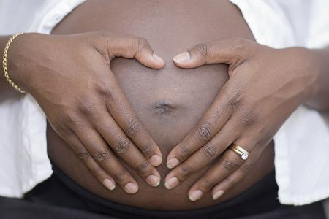
MTN-016
Woman Follow-Up
Procedures

Slide 2
MTN-016: Woman Follow-up
Women enrolled while pregnant have quarterly follow-up visits through pregnancy outcome
Target dates are based on the date of MTN-016 enrollment, so women will have different numbers of follow-up visits depending on when they enroll
Visit windows are contiguous with a +/- 45 day window on either side of the target.

Slide 3
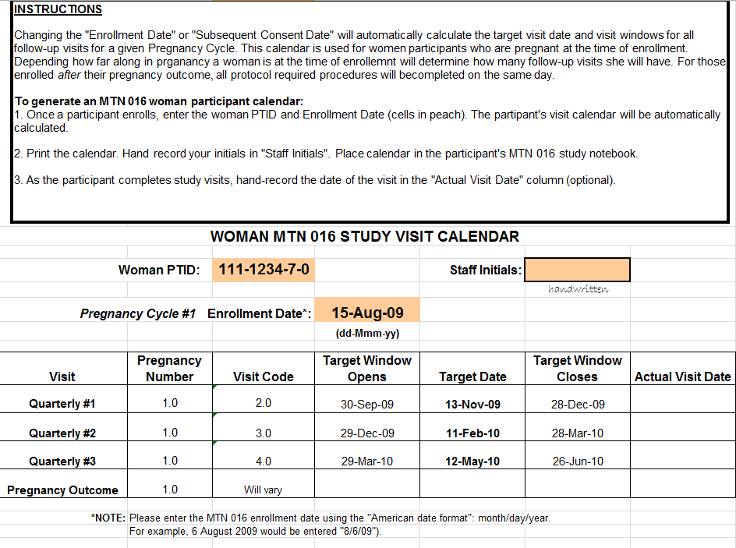
Notes:
Visit scheduling tool available for download from MTN website – SCHARP is working on updating this tool and will cover in more detail during the data training.

Slide 4
Quarterly Visit Procedures
Update Locator
Update Medical/Medication History
Update Pregnancy Report & History (including related morbidities)
Update Genetic Screening History
Reimbursement/Schedule Next Visit
Minimum of one Ultrasound (perform or refer), ideally between 20-28 weeks
As Indicated:
Ascertain Information on Pregnancy Outcome
Social Harms Assessment
Notes:
Sites should inquire about social harms at each visit and, if a social harm is reported, document this on the social harms assessment log form.

Slide 5
Helpful Tips
Some data collected for MTN-016 and ASPIRE will overlap, especially woman data (e.g. medical/medication history, pregnancy history/outcome)
Procedures and documented results from the parent may be utilized for MTN-016, if the procedure(s) was performed/sample(s) was collected in the visit window and within the past 30 days
Don’t duplicate documentation
when not necessary – certified copies
are your friend
Study files for 016 and ASPIRE
need to stand alone – certified copies
are your friend

Slide 6
Helpful Tips
Although there is no AE reporting in MTN-016 (since there is no investigational product), clinical events identified in MTN-016 may be considered AEs in parent study.
Events that qualify as AEs in the parent protocol need to be documented and reported as such.
How will your site team make sure this is done?

Slide 7
Pregnancy Outcome
The Pregnancy Outcome information will always be collected in conjunction with another study visit:
Screening and Enrollment (if delivery precedes screening and enrollment)
Quarterly Visit or Interim Visit, depending on visit windows.

Slide 8
Pregnancy Outcome Procedures
Complete Screening and Enrollment, Quarterly or Interim visit procedures as indicated on the appropriate checklist.
Additionally, obtain pregnancy outcome data:
Type and number of pregnancy outcome(s).
Gestational age based on obstetric assessment at pregnancy outcome.
If live birth, method of delivery.
Complications related to pregnancy outcome.
Baseline infant information.

Slide 9
Pregnancy Outcome Considerations
What procedures do you have in place at your site for ensuring timely capture of labor and delivery data?
The procedures are site specific. Discuss with participant the importance of notifying study staff after delivery. Consider contact with local hospital/how you will obtain L&D data
After learning of her delivery, what steps must you now take?
Collect pregnancy outcome data (at quarterly or interim visit, possibly in conjunction with ASPIRE monthly visit), schedule newborn visit within 10 days

Slide 10
Adverse Pregnancy Outcomes
Should be capturing these via careful chart review
Prenatal record
Records from labor ward or operating theatre
May also be noted on records from post-natal visit or even baby’s chart
Delivery <37 completed weeks of gestation | Non-reassuring fetal status
Stillbirth or intrauterine demise (≥ 20 weeks) | Intrapartum or postpartum hemorrhage
Spontaneous abortion (< 20 weeks) | Hypertensive disorders of pregnancy
Ectopic pregnancy | Gestational diabetes
Chorioamnionitis | Intrauterine growth restriction

Slide 11
Interim Visits - Mother
Possible reasons for interim visit:
Report pregnancy outcome
Perform U/S assessment
Report social harm

Slide 12
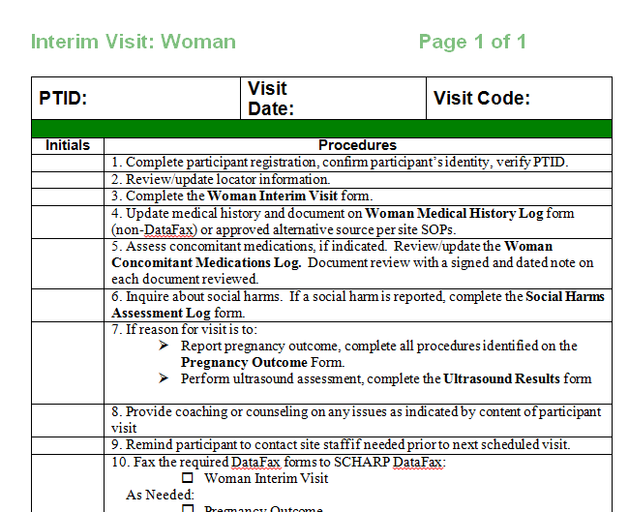
Interim Visit Procedures – Mother
Update Locator
As Indicated:
Update Medical History
Update Medication History
Update pregnancy history
Social Harms Assessment
Schedule next visit
Reimbursement

Slide 13
Interim Visit Example
If the first time an MTN-016 participant returns to ASPIRE with a newborn her third quarterly visit window has closed OR she is within the window of a visit she has already completed:
Conduct an interim visit to collect pregnancy outcome data.
The Newborn/Initial Visit could also be conducted on this day (more on that later!)
Notes:
Forms to Complete for the mother:
Interim Visit form*
Updates to:
Locator form
Genetic Screening History form
Con meds log/Social harms log/Medical history log
Inquire if U/S results are available
If applicable, Pregnancy Outcome form and Medical record release form to obtain labor & delivery records
*Note that assignment of an interim visit code and completion of the interim visit form are only completed if a new data fax CRF is completed during the visit.
LAM: We should avoid saying “outside of a visit window” for the mom’s because they are never outside of a window – the windows for moms are continuous and they are always inside some window. I would be specific in this example and say ‘she is in the visit window for the 2nd quarterly visit, which she has already completed’.

Slide 14
Follow-Up Visit Scenario 1
Sarah, an ASPIRE participant, has been co-enrolled on MTN-016 for about 2 months. She has not had her first quarterly MTN-016 visit.
During a monthly ASPIRE visit, she reports that she has felt “different” lately and that she had three or four days of bleeding and cramping since her last visit.
Her pregnancy test is negative.
Notes:
Questions to consider:
- Should you treat as a MTN-016 visit, if so what type?
What procedures might you need to consider as part of MTN-016? Do they overlap with ASPIRE procedures?
What CRFs might you need to consider?

Slide 15
Follow-Up Visit Scenario 1
Should you treat as a MTN-016 visit?
She is within the visit window for the first quarterly visit, so you could conduct her MTN-016 visit at this time
Pregnancy Outcome Data should be collected.
Note: If ppt had already completed the first quarterly visit, could collect pregnancy outcome data during an interim visit

Slide 16
Follow-Up Visit Scenario 1
Is the woman terminated from the study at this time?
No. MTN-016 participants are terminated when they terminate from the parent protocol. The Pregnancy Outcome Visit does not signify termination from the study, but does signify the end of follow-up until a subsequent pregnancy is reported or a valid reason for termination occurs.
Does the fetal loss need to be reported as an AE in the parent protocol?
No. Fetal losses are not reported as AEs in ASPIRE. However, untoward maternal conditions that either result in or result from fetal losses are reported as reproductive system AEs.

Slide 17
Follow-Up Scenario 2
Rebecca is enrolled in MTN-016 and ASPIRE, and is approximately 30 weeks pregnant.
During her second MTN-016 quarterly visit, she confirms her intention to deliver at the local hospital.

Slide 18
Follow-Up Scenario 2
Following her second quarterly visit, Rebecca misses several ASPIRE visits and also doesn’t show up for her third 016 quarterly visit.
A visit to her home reveals that she’s returned to her home village to deliver her baby.
When Rebecca reappears at the MTN-016 clinic, her baby is a month old.

Slide 19
Follow-Up Scenario 2
During what type of MTN-016 visit will you collect pregnancy outcome data?
If still within the visit window, conduct the third quarterly visit. If not, this will be an interim visit.
How will your site approach obtaining labor and delivery records in this case?
Notes:
Forms to Complete for the mother:
Quarterly visit forms (WFU, U/S, updates to locator, genetic screening, con meds, social harm, medical history)
PLUS
Pregnancy Outcome form
Medical record release form to obtain labor & delivery records, if available
Pregnancy outcome: type/number of pregnancy outcome, gestational age; delivery type; complications, baseline infant information: number (singleton, twin, etc.) sex, weight, length, head circumference, apgar scores, medical/medication history.

Slide 20
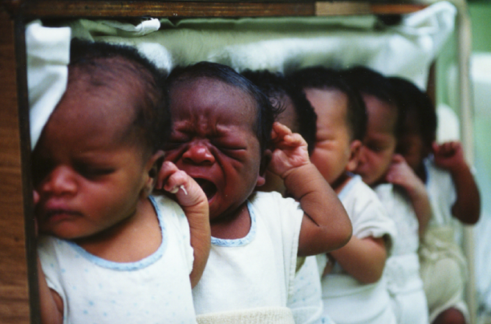
Pregnancy Outcome Scenario
Rebecca indicates/has indicated that she does not want her baby to participate in MTN-016.
Can you collect any infant data for MTN-016?
Yes. Consent of the woman allows for collection of infant data that are recorded on the labor and delivery notes (e.g. apgars, length and weight, gestational age, etc.). However, no other infant data can be collected without consent.

Slide 21
MTN-016
Subsequent Pregnancy Procedures

Slide 22
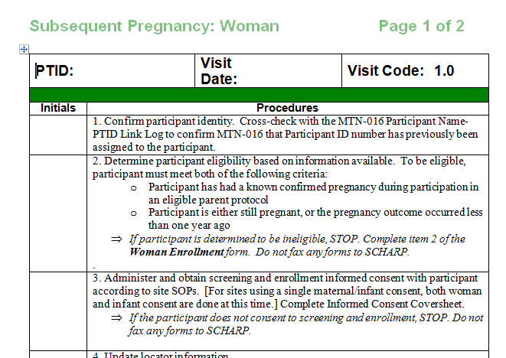
Subsequent Pregnancy
Maternal inclusion and exclusion criteria are the same for subsequent pregnancies as for first time participants.
Reconsent for MTN-16 is required
Participant maintains the same 016 PTID for all pregnancies.
Note: Think about binder
organization for subsequent
pregnancies.

Slide 23
Subsequent Pregnancy
Each subsequent pregnancy represents a new and unique mother/infant pair
New Documentation | Updated | Not Repeated
Informed Consent Genetic Screening History Ultrasound Report Pregnancy Report/History All F/U visit forms including U/S and pregnancy outcome | Medical History Con Meds | Enrollment Demographics Parent protocol participation
Notes:
Not filled out again: Enrollment, demographics, parent protocol participation
SAME (but updated): medical history, con med
New for this pregnancy: subsequent consent, genetic screening history (Father may be different
May want to use genetic history from first pregnancy as a prompt, but not to copy), ultrasound results, pregnancy report and history, all follow-up visit forms/ultrasound/pregnancy outcome.

Slide 24
Questions?

